Slide 1
Request Self-Service Portal
IT Service Desk

Slide 2
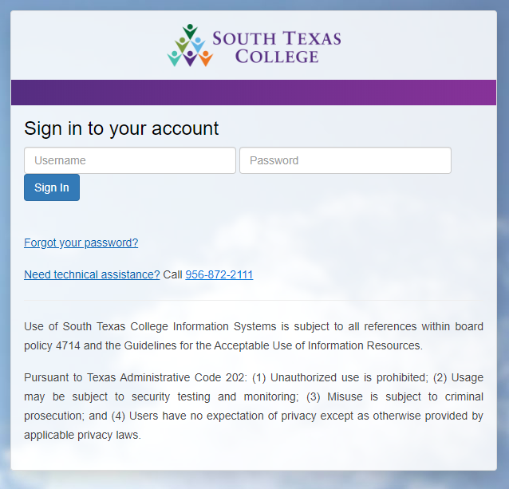
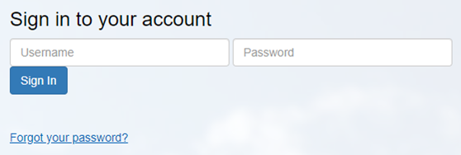
Logging on to Portal
Open any browser (Chrome, Firefox, etc.)
https://isphelp.southtexascollege.edu
Enter your JagNet credentials:
User Name
Password
Click the Sign In button.

Slide 3
Select a Service
Create a new ticket
View/Submitted Requests
View/Edit My Profile

Slide 4
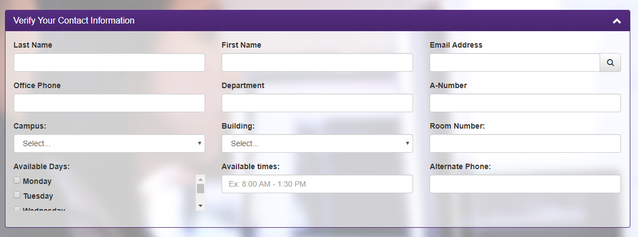
Verify the Contact Information
Last Name
First Name
Email Address
Etc.
This information is automatically entered based on the Username and password.

Slide 5
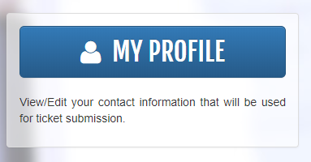
Verify the Contact Information
If there are any inaccuracies or blank spaces, click on “Home” in the header.
Select “My Profile” button and enter the correct or additional information.
Clicking on the “Save Changes” button in the bottom right of the screen.
**The corrections or additional information will automatically appear the next time the person logs in. Make sure to fill out everything.

Slide 6
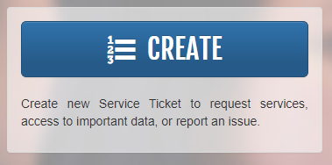
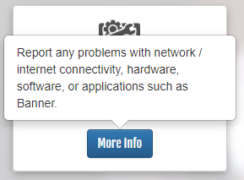
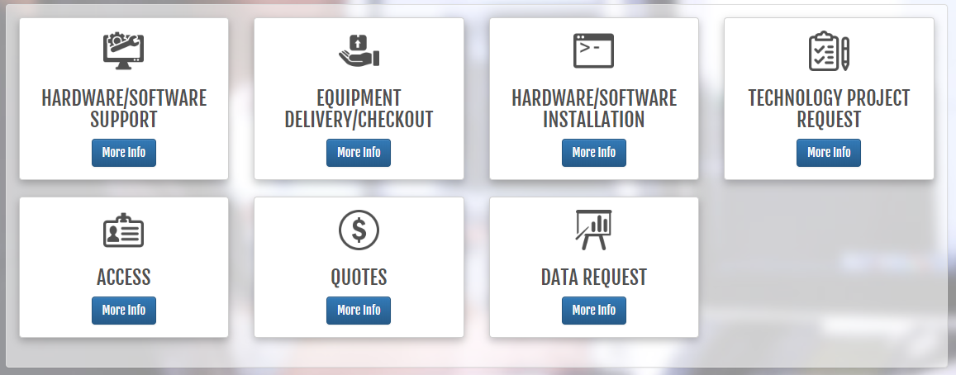
Creating Tickets
Click on “Home” in the header. **To go back to main screen.
Click “Create” to make ticket.
Click the tile that best helps your needs.
If more information needed regarding what is included in that tile, click the “More Information” button.
**To close the information window, click the “More Information” button again.

Slide 7
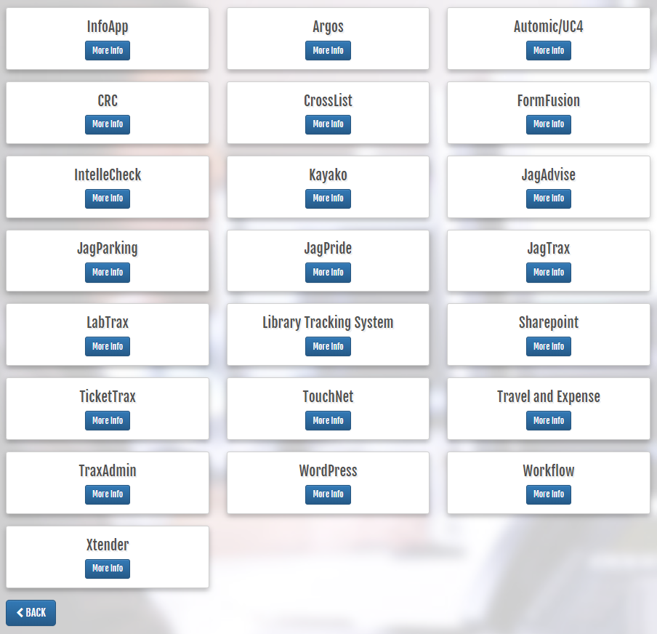
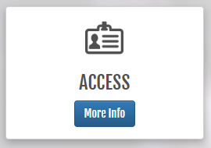
Creating Tickets
**Continue to make choices until you are able to complete the ticket.
For example Creating a ticket:
Click on “Access” and other options will appear.
Click on “Applications” and other options will appear.

Slide 8
Creating Tickets
Once you click on the tile that you need, complete the information needed below.
Some requests require supervisor’s approval. If so, there will be a place to enter the email of the supervisor.
Click the “Submit Request” button located in the bottom right of the screen.

Slide 9
Supervisor Approval
An email is automatically sent to the supervisor alerting them to take action
The supervisor logs into the system as detailed above and will note the addition of a fourth button.
Click on the Pending Approvals button.
The supervisor will see all tickets that require approval.
Information includes the following:
Ticket number
Date ticket created
Type of ticket
Information provided by the requestor

Slide 10
Supervisor Approval
Click on the ticket and a new window will open with additional information.
To approve or disapprove the request, click on the “Disapprove” button or the “Approve” button to complete the process.
An email will automatically be sent to the requestor with the decision.

